Slide 1
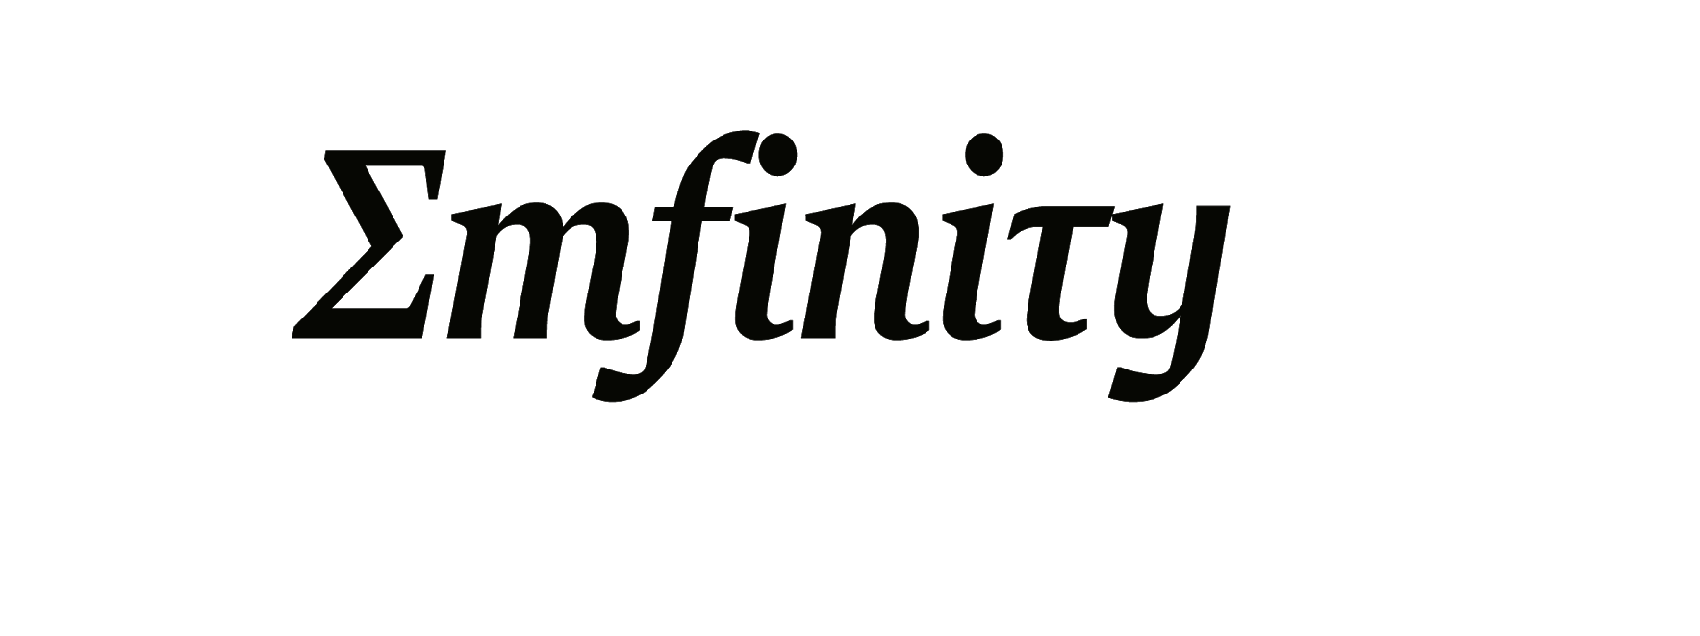

Title : Neural Networks
By Team Emfinity

Slide 2

What is a neural network ?
A neural network is a type of machine learning which models itself after the human brain. This creates an artificial neural network that via an algorithm allows the computer to learn by incorporating new data.

Slide 3
Neural Network Technique
Neural networks learn from examples
No requirement of an explicit description of the problem.
No need for a programmer.
The neural computer adapts itself during a training period, based on examples of similar problems even without a desired solution to each problem.
After sufficient training the neural computer is able to relate the problem data to the solutions, inputs to outputs, and it is then able to offer a viable solution to a brand new problem.
Able to generalize or to handle incomplete data.

Slide 4
Who is concerned with NNs?
Computer scientists want to find out about the properties of non-symbolic information processing with neural nets and about learning systems in general.
Statisticians use neural nets as flexible, nonlinear regression and classification models.
Engineers of many kinds exploit the capabilities of neural networks in many areas, such as signal processing and automatic control.
Cognitive scientists view neural networks as a possible apparatus to describe models of thinking and consciousness (High-level brain function).
Physicists use neural networks to model phenomena in statistical mechanics and for a lot of other tasks.
Biologists use Neural Networks to interpret nucleotide sequences.

Slide 5

Biological Inspiration : A NEURON

Slide 6
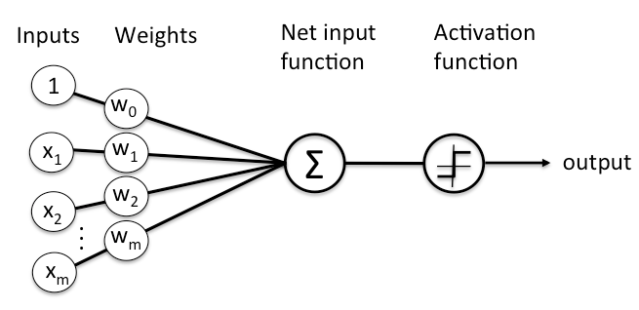
Basic Architecture
Neural computing requires a number of neurons, to be connected together into a neural network.
Neurons are arranged in layers.
Each neuron within the network is usually a simple processing unit which takes one or more inputs and produces an output.
At each neuron, every input has an associated weight which modifies the strength of each input.
The neuron simply adds together all the inputs and calculates an output to be passed on.

Slide 7
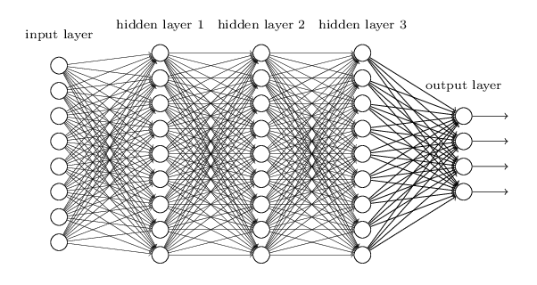
WHAT AN ACTUAL NEURAL NETWORK LOOKS LIKE . . .

Slide 8
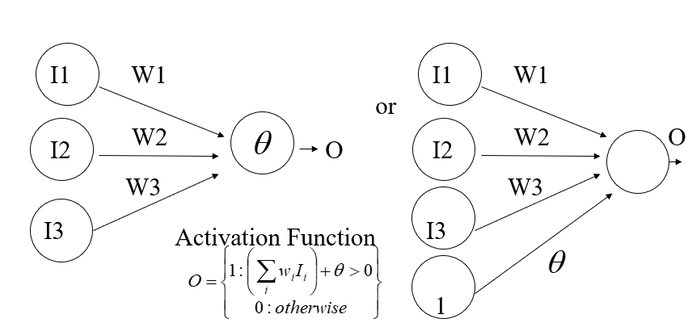
Perceptron – The simplest ANN
Initial proposal of connectionist networks
By Rosenblatt, 50’s and 60’s
Essentially a linear discriminant composed of nodes, weights

Slide 9
Learning Process
Randomly assign weights (between 0-1)
Present inputs from training data
Get output O, nudge weights to gives results toward our desired output
Repeat; stop when no errors, or enough epochs completed
Can add learning rate to speed up the learning process

Slide 10
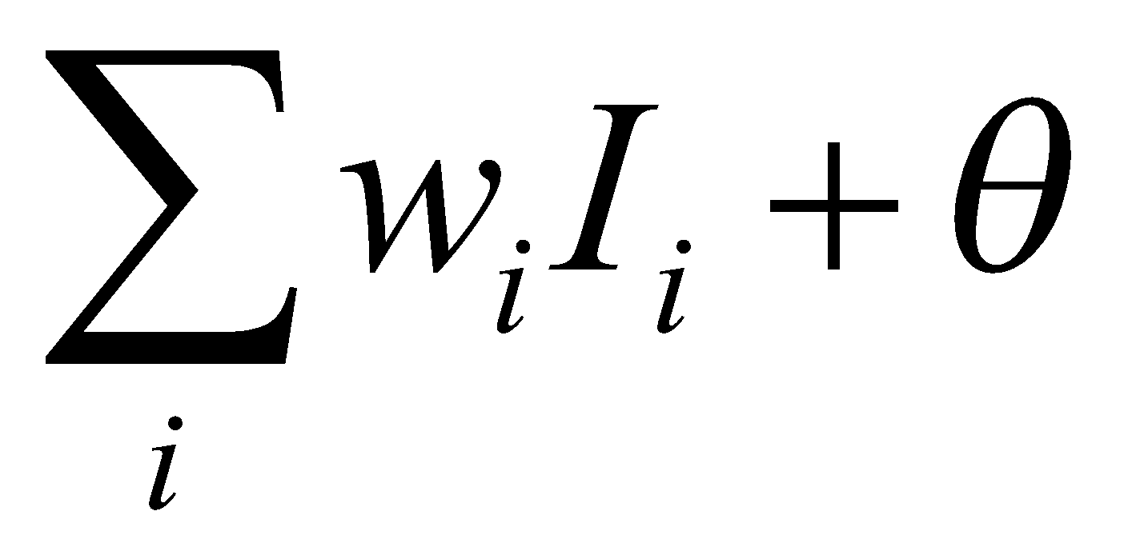
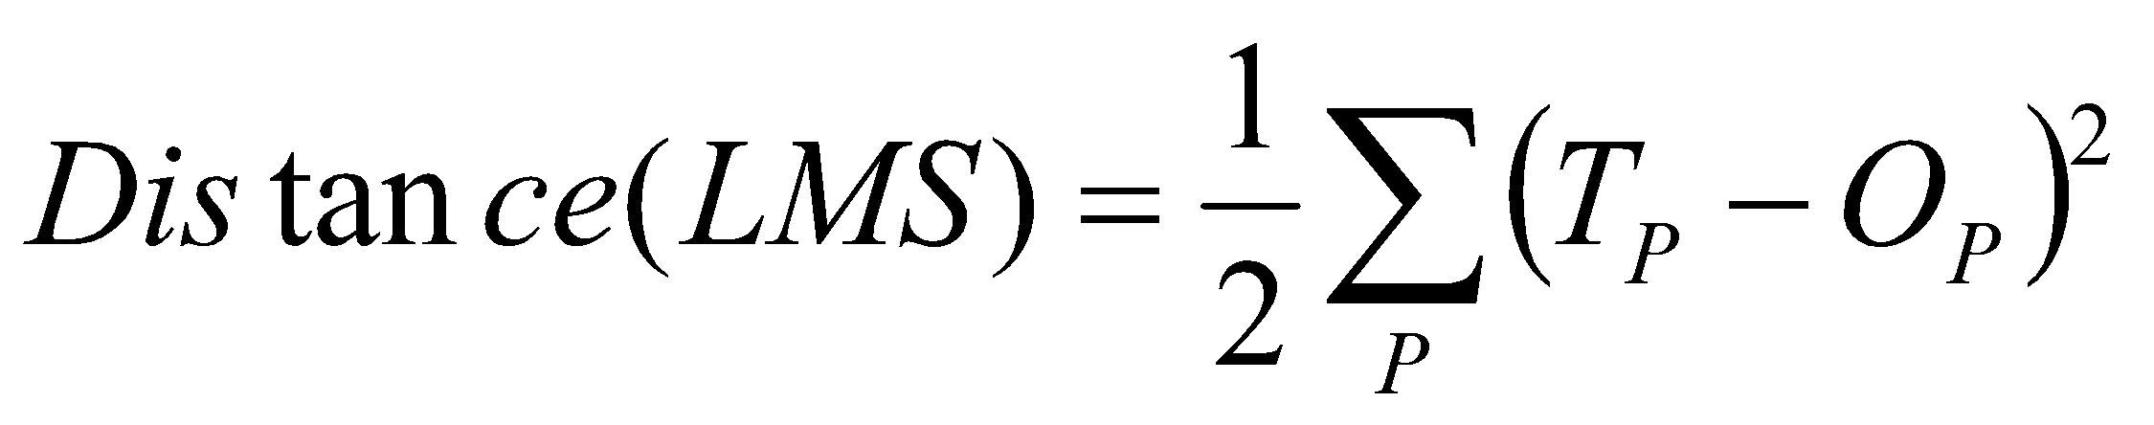
LMS Learning
LMS = Least Mean Square learning Systems, more general than the previous perceptron learning rule. The concept is to minimize the total error, as measured over all training examples, P. O is the raw output, as calculated by
Desired output
Actual output
E.g. if we have two patterns and
T1=1, O1=0.8, T2=0, O2=0.5 then D=(0.5)[(1-0.8)²+(0-0.5)²]=.145
W

Slide 11
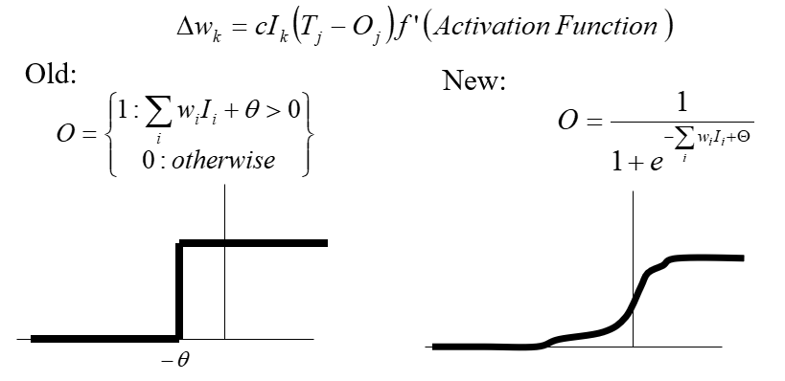
Activation Function
To apply the LMS learning rule, also known as the delta rule, we need a differentiable activation function.

Slide 12
LMS vs. Limiting Threshold
With the new sigmoidal function that is differentiable, we can apply the delta rule toward learning.
Perceptron Method
Forced output to 0 or 1, while LMS uses the net output
Guaranteed to separate, if no error and is linearly separable
Otherwise it may not converge
Gradient Descent Method:
May oscillate and not converge
May converge to wrong answer
Will converge to some minimum even if the classes are not linearly separable, unlike the earlier perceptron training method

Slide 13
How does Back Propagation work ?
Randomly assign weights (between 0-1)
Present inputs from training data, propagate to outputs
Compute outputs O, adjust weights according to the delta rule, backpropagating the errors. The weights will be nudged closer so that the network learns to give the desired output.
Repeat; stop when no errors, or enough epochs completed

Slide 14
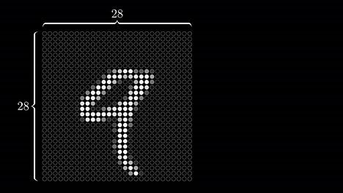
Visual representation of neural network inputs

Slide 15
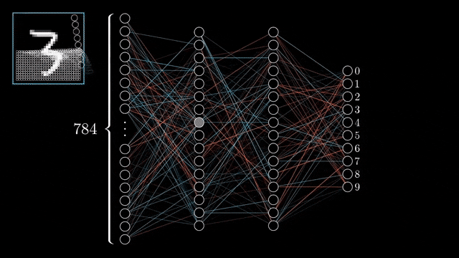
Training Example

Slide 16
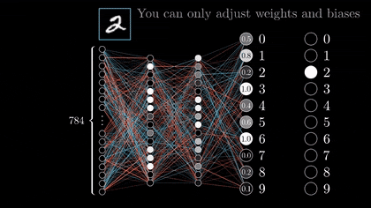
Backpropagation

Slide 17
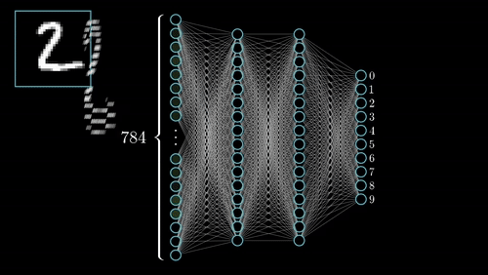
Desired output

Slide 18
What can you do with an NN and what not?
NNs can compute any computable function, i.e., they can do everything a normal digital computer can do.
Almost any mapping between vector spaces can be approximated to arbitrary precision by feedforward NNs .
In practice, NNs are especially useful for classification and function approximation problems usually when rules such as those that might be used in an expert system cannot easily be applied.
NNs are, at least today, difficult to apply successfully to problems that concern manipulation of symbols and memory.
There are no methods for training NNs that can magically create information that is not contained in the training data.

Slide 19
Applications of Neural networks
in marketing: consumer spending pattern classification
In defence: radar and sonar image classification
In agriculture & fishing: fruit and catch grading
In medicine: ultrasound and electrocardiogram image classification, EEGs, medical diagnosis, recognition and identification
In general computing and telecommunications: speech, vision and handwriting recognition
In finance: signature verification and bank note verification/assessment
In engineering: product inspection monitoring and control
In security: motion detection, surveillance image analysis and fingerprint matching and prediction
In finance: foreign exchange rate and stock market
In marketing: sales forecasting

Slide 20
Extra graphics

